Slide 1


Power System for the Phoenix CubeSat
Raymond Barakat
Mentor: Daniel White, PhD
26th Annual Arizona Space Grant Consortium Symposium

Slide 2

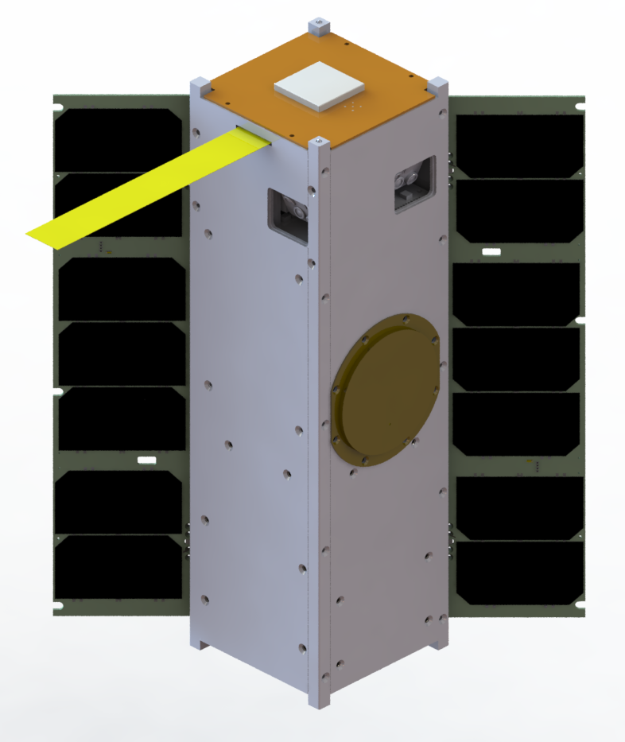



Background
Phoenix is an undergraduate led CubeSat Project funded by NASA’s USIP program
The NASA grant was applied for and granted to ASU’s School of Earth and Space Exploration and the Sun Devil Satellite Laboratory
The goal of the satellite is to take infrared images of cities in the US in order to characterize the urban head island effect.
The satellite will be launch ready by March 2018
March 17th, Phoenix PDR

Slide 3
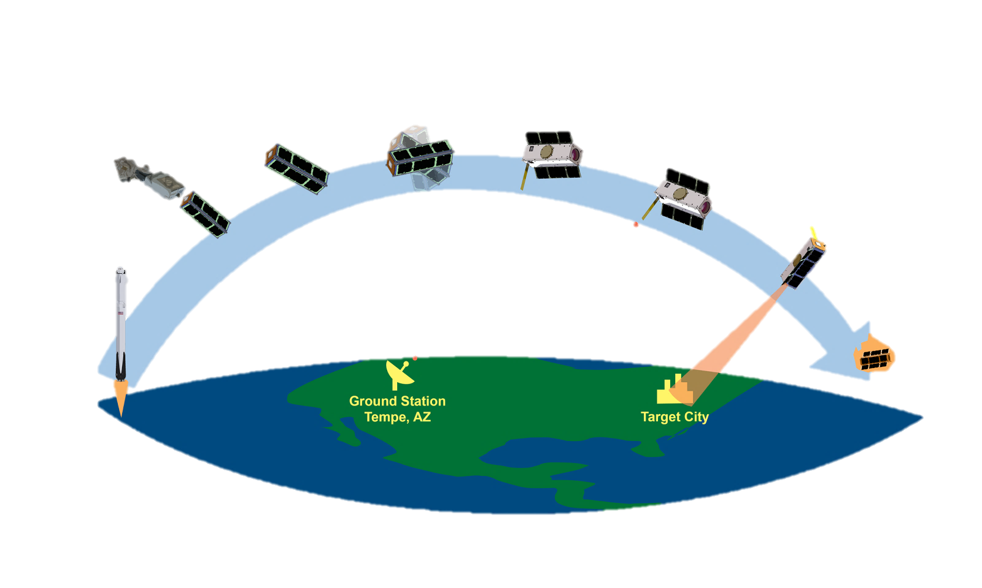
Background – Phoenix Mission Timeline
Detumble
Appendages Deploy
Deployment
Sleep
Stand By
Main Mission
Launch
Decay and Reentry
March 17th, Phoenix PDR

Slide 4
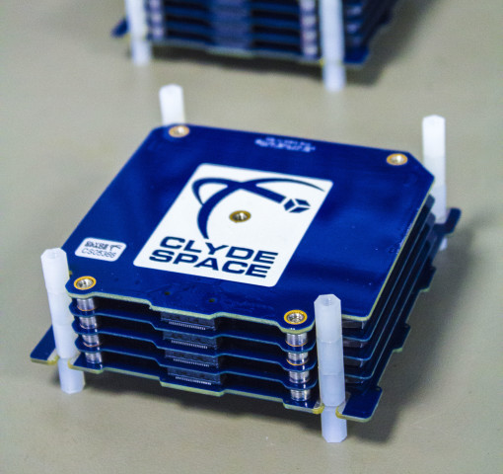
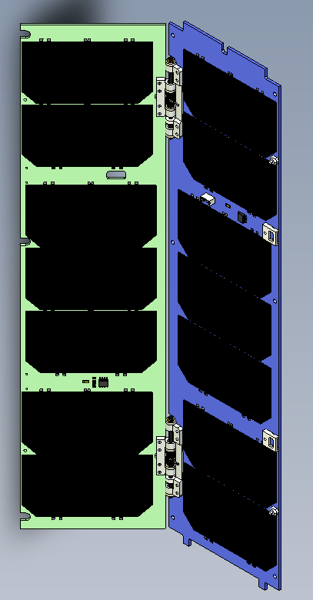
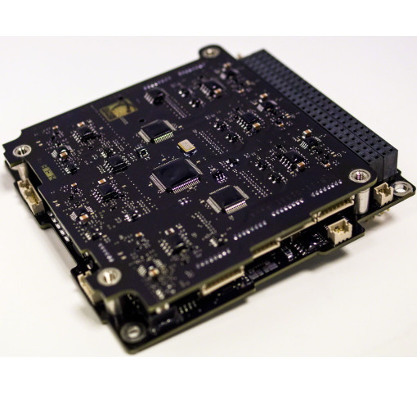
Project Objective
The goal of this project is to:
  Develop models to accurately calculate solar power generation
  Characterize each of the operation modes of the satellite to make an accurate power consumption model
  Combine this data into a comprehensive power budget in order to choose the best possible power system
March 17th, Phoenix PDR

Slide 5
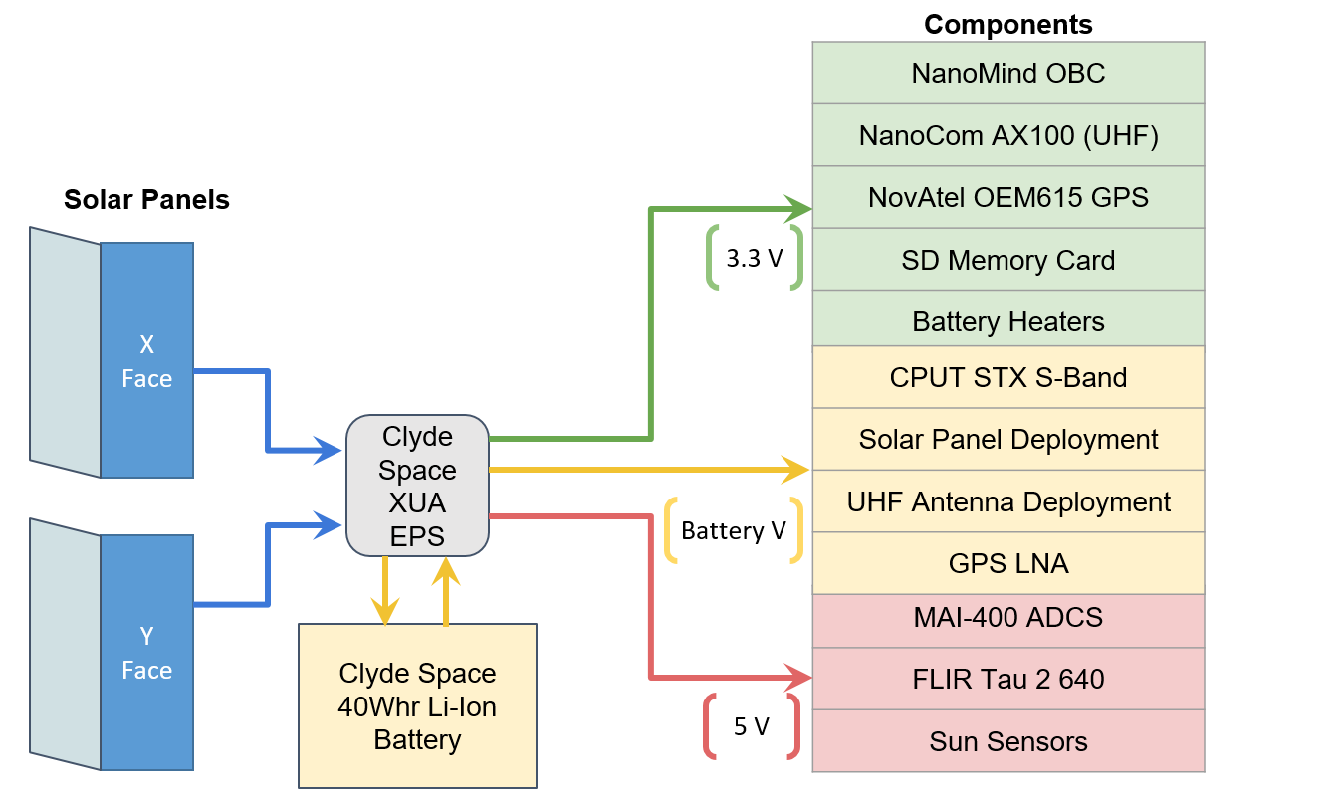
Power Systems Overview
March 17th, Phoenix PDR

Slide 6
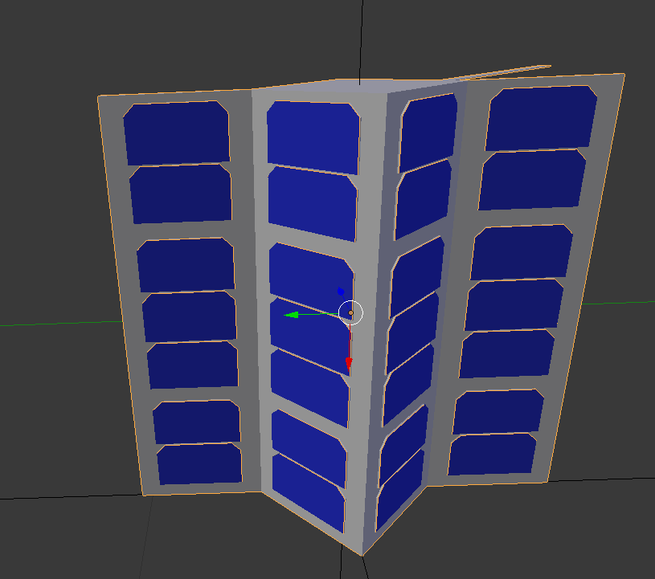
Analysis Method – Creating a Model
3D model, STL file, created in SolidWorks
Model is edited denote the solar cells in Blender.
Rotation/pointing vectors defined in Blender and edited in the ANC and DAE files using Notepad++.

Slide 7
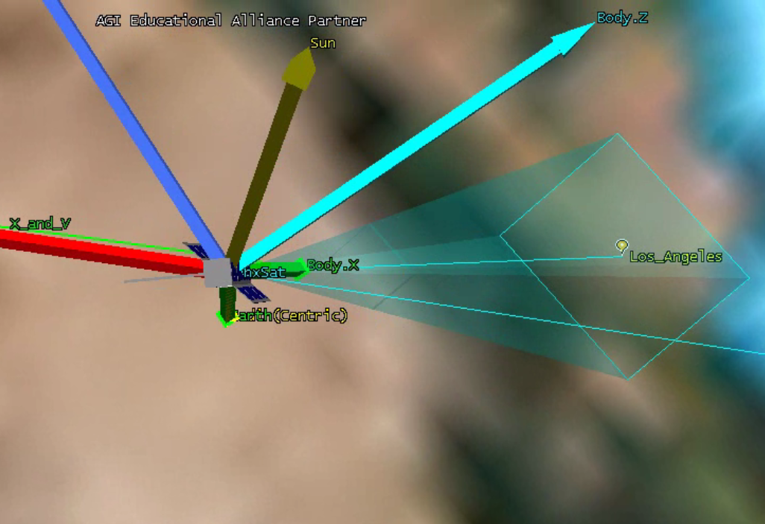
Analysis Methods – Data Processing
The Collada (DAE) and Ancillary (ANC) files are imported into STK to simulate the satellite in various orbits and pointing orientations.
CSV files output by STK are imported into MATLAB to create plots and calculate average power over an orbit and average energy produced.
Lastly, the numbers are compared with the worst case average power draw of the various components on the satellite.

Slide 8
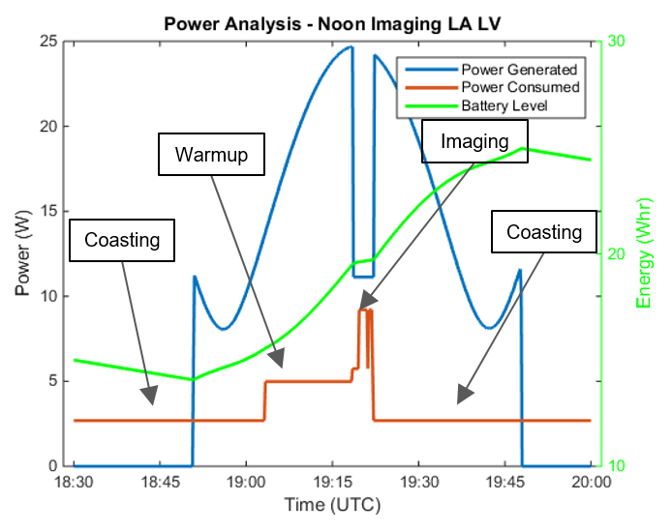
Results – Example Orbit
Imaging near noon of Los Angeles and Las Vegas
Energy Margin % = (Energy Generated - Energy Consumed) / Energy Generated
Energy Margin % = 65.6% margin
 | Avg Power (W) | Energy (Whr)
Generated | 9.55 | 14.34
Consumed | 3.28 | 4.93
Margin | 6.27 | 9.41

Slide 9
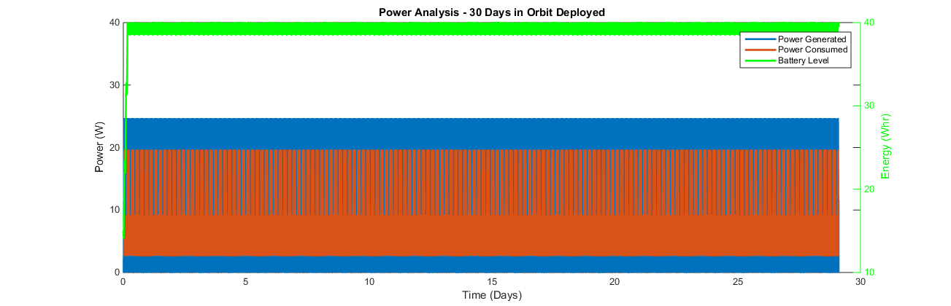
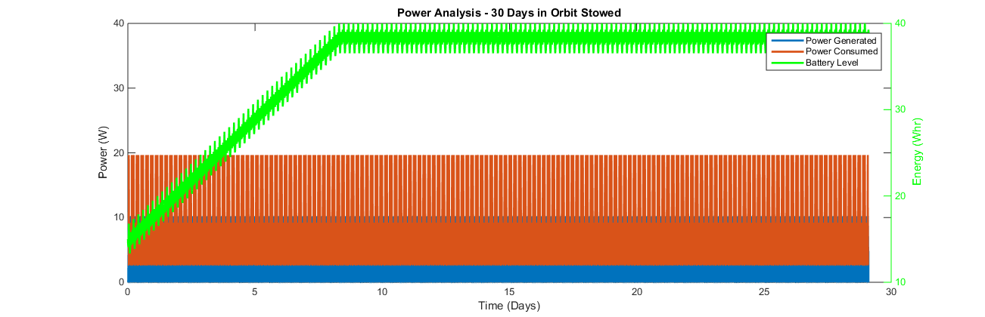
Conclusions
Both deployed and stowed are power positive.
Deployed reaches maximum battery level in a few orbits
Stowed reaches maximum battery level in about 9 days
A deployable design is more than sufficient for mission success.

Slide 10
Acknowledgements
Dr. Daniel White
ASU SESE
ASU/NASA Space Grant
SDSL
Jaime Sanchez de la Vega – Phoenix CubeSat Principal Engineer
Sarah Rogers - Phoenix CubeSat Project Manager
Aditya Khuller - Phoenix CubeSat Power Subsystem
My Capstone team: Alexander Willoughby, Jordan Brown, Jordan Schmidt
Phoenix Capstone team: Jason Ruchal, Chad Davis, Kregg Castillo, Kristen Murphy

